Slide 1
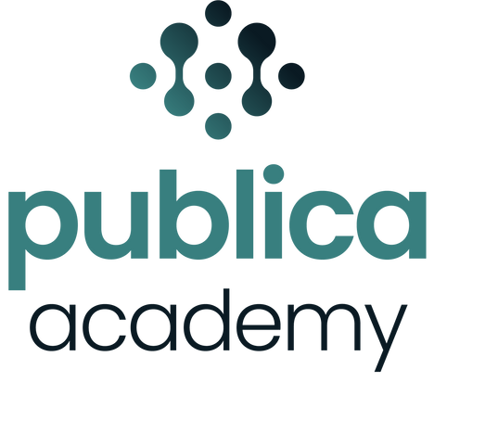
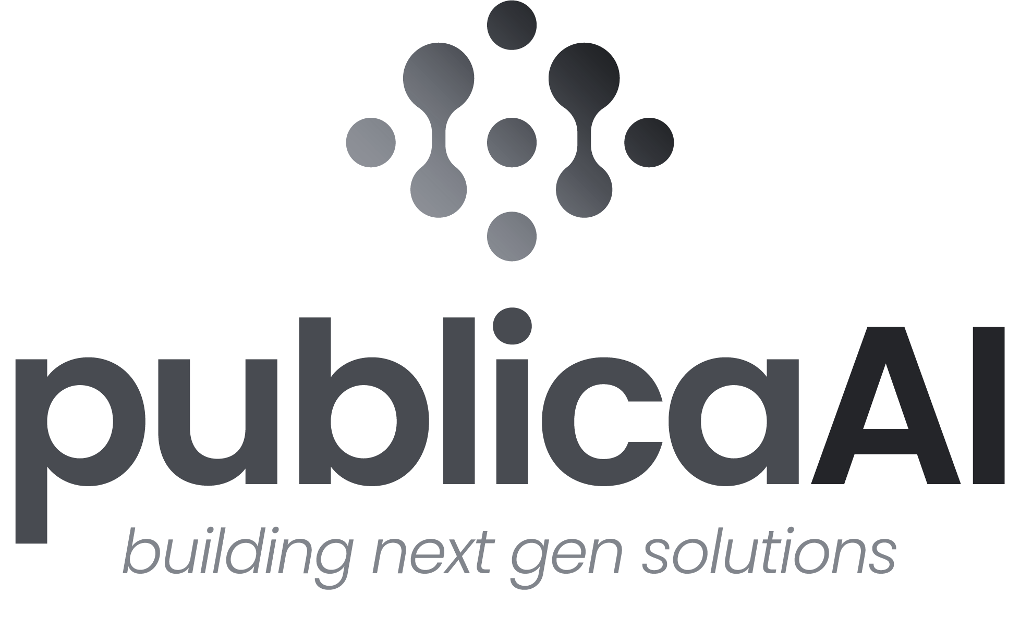
ADVANCED RETRIEVAL AUGMENTED GENERATION (RAG) & EVALUATION
A practical course for intending and professional AI Developers
Yusuf Anigilaje
AI Developer, Publica AI

Slide 2

Course Objectives
By the end of this section, you will be able to:
  Understand the limitations of basic retrievers in RAG systems
  Identify and explain at least 7 advanced retriever techniques used in modern RAG pipelines
  Compare the strengths and weaknesses of each technique
  Select the appropriate retriever(s) based on use case, data type, and complexity
  Apply advanced retriever techniques to build more accurate and efficient RAG systems
www.publica.academy

Slide 3
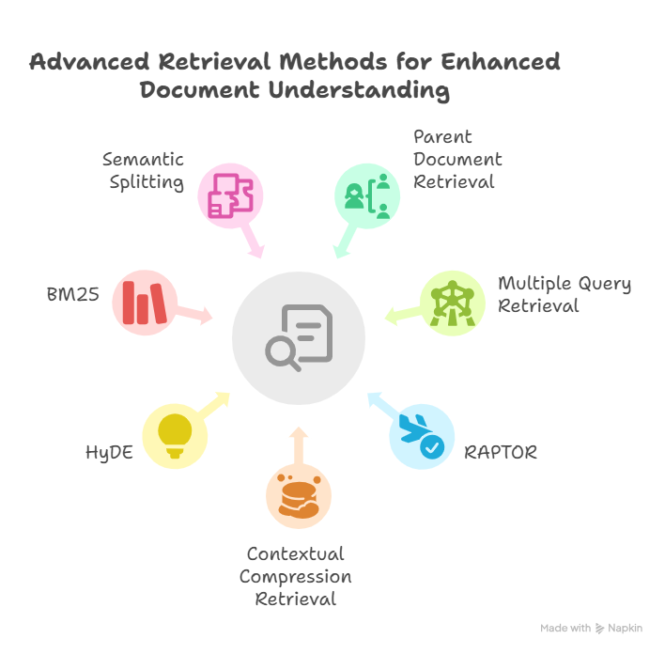
Why Go Beyond Basic Retrieval?
Limitations of basic retrievers:
  Retrieve too much or too little
  Miss key context
  Struggle with complex queries
  Waste tokens in the LLM
Advanced retrievers solve these by:
✅ Improving relevance
✅ Compressing context
✅ Supporting deeper reasoning
✅ Expanding query interpretation
www.publica.academy

Slide 4
Here are some Advance Retriever techniques:
  Parent Document Retriever
  Multiple Query Retriever
  Raptor
  Contextual Compression Retrieve
  HyDE (Hypothetical Document Embeddings)
  BM25
  Semantic Splitting
1
www.publica.academy

Slide 5
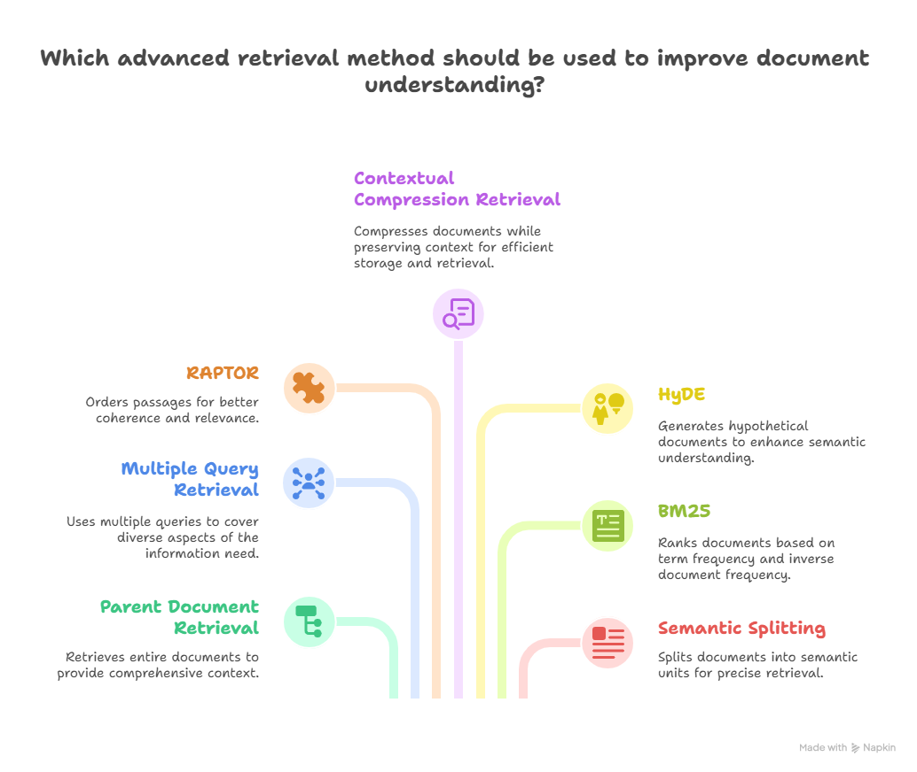
www.publica.academy

Slide 6
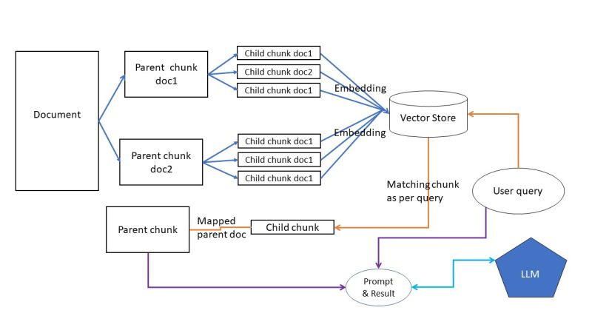
Parent Document Retriever
  Many RAG systems split documents into small chunks for retrieval. Small chunks may miss important context needed to answer questions.
  The Parent Document Retriever embeds smaller chunks for efficient search but retrieves the full parent document for the LLM. Combines the benefits of concise retrieval with access to complete context for accurate generation.
www.publica.academy

Slide 7
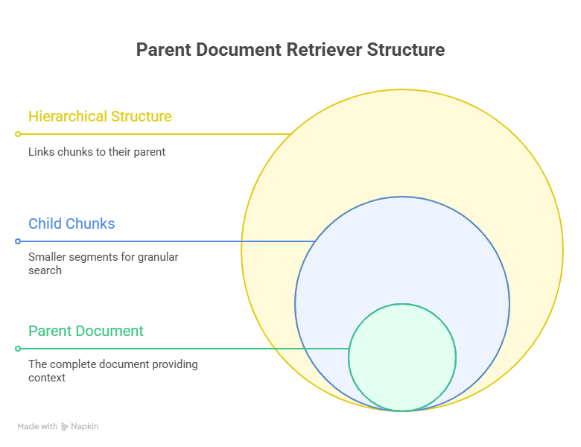
Parent Document Retriever
Benefits:
  Improved Context: Provides more context than individual chunks, aiding in better understanding.
  Reduced False Positives: By considering the parent document, the retriever can filter out irrelevant chunks that might be semantically similar to the query but are not relevant in the larger context.
Use Cases:
  Legal Document Retrieval: Retrieving entire legal clauses or sections instead of isolated sentences.
www.publica.academy

Slide 8
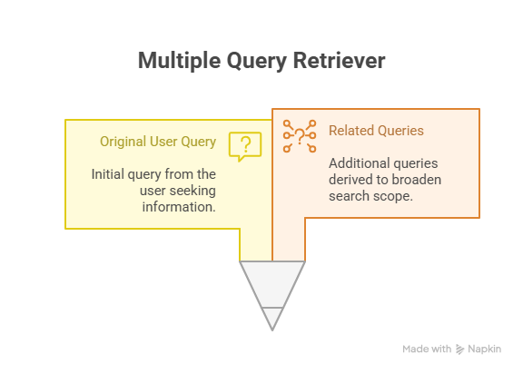
Multiple Query Retriever
Problem:
  Traditional retrieval methods often miss relevant information by relying on a single query formulation.
  Important context can be lost when retrieving documents based on a single perspective.
solution :
  Multi-Query Approach Rewrites the original query from multiple perspectives.
  This method improves retrieval accuracy by capturing diverse aspects of the query, ensuring more comprehensive context.
www.publica.academy

Slide 9
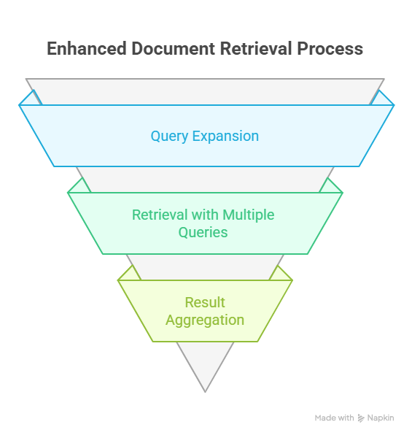
Multiple Query Retriever
How it Works:
  Query Expansion: The original query is expanded into multiple related queries using techniques like:
    Rephrasing the query in different ways.
    Generating queries that focus on different aspects of the original query.
  Retrieval with Multiple Queries: Each generated query is used to retrieve relevant documents or chunks from the index.
  Result Aggregation: The results from all queries are combined and ranked based on relevance scores.
www.publica.academy

Slide 10
RAPTOR
  RAG systems must handle specific (single-doc) and broad (multi-doc) questions that span many documents, which is challenging with typical retrieval methods.
  Raptor: Creates a tree of summaries by recursively clustering and summarizing documents. Captures both fine details and high-level concepts. Indexes summaries and original documents, providing coverage across all user questions.
RAPTOR solves the retrieval-scope mismatch problem — where basic RAG fails to handle both fine-detail questions and broad, cross-document questions. It does this by building a tree of summaries that provides:
  Local information
  Mid-level summaries
  Global, cross-document understanding
All in one structure.
www.publica.academy

Slide 11
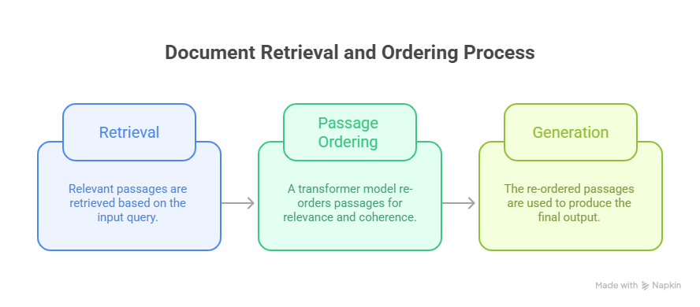
RAPTOR
Benefits:
  Improved Coherence: Ensures that the retrieved passages are presented in a logical and coherent order.
  Enhanced Relevance: Prioritizes passages that are most relevant to the query.
Use Cases:
  Summarization: Generating coherent summaries from multiple documents.
  Question Answering: Providing comprehensive and well-structured answers to complex questions.
www.publica.academy

Slide 12
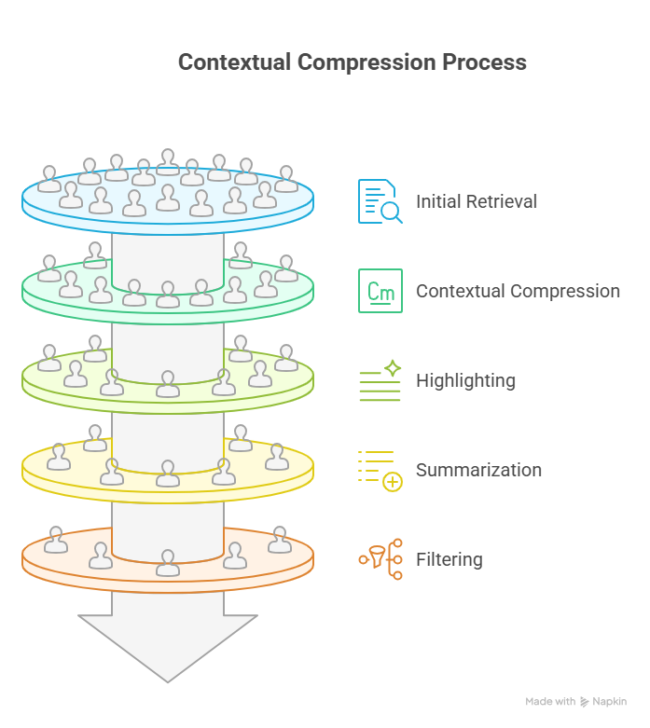
Contextual Compression
One of the biggest problems in RAG is retrieving entire documents or large chunks that contain irrelevant information.
Contextual Compression Approach:
  Extracts only the most relevant parts of retrieved documents.
  Compresses information for more focused and efficient retrieval.
  Improves relevance while reducing unnecessary data.
www.publica.academy

Slide 13
Contextual Compression
Benefits:
  Reduced Noise: Filters out irrelevant information, improving the signal-to-noise ratio.
  Improved Efficiency: Reduces the amount of text that needs to be processed, saving computational resources.
Use Cases:
  Extracting the most relevant information from a large document to answer a specific question.
  Chatbots with Limited Context Windows
www.publica.academy

Slide 14
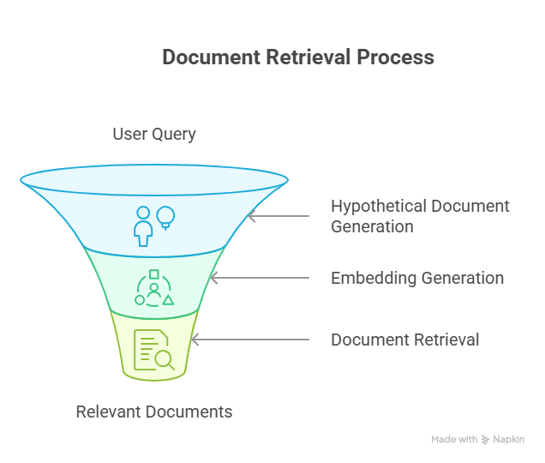
HyDE (Hypothetical Document Embeddings)
  Some retrieval methods may not always find the most relevant documents due to limitations in keyword matching.
  Queries might not directly align with indexed documents, leading to suboptimal retrieval results.
www.publica.academy

Slide 15
Solution: HyDE Approach:
    Uses LLMs to generate hypothetical documents based on the query.
    Converts these hypothetical documents into embeddings.
    Retrieves indexed documents that best align with these generated embeddings.
This method enhances retrieval quality by bridging the gap between user intent and stored information by generating an LLM-created “ideal answer” that better represents what the user is looking for, then using it to find the closest real documents.
www.publica.academy

Slide 16
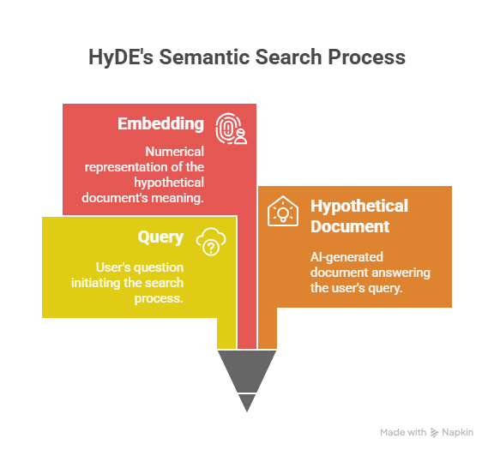
Solution: HyDE Approach:
  Use Cases:
    Patent Search: Finding patents that are related to a specific invention, even if they use different terminology.
    Scientific Literature Search: Discovering research papers that address a specific research question.
www.publica.academy

Slide 17
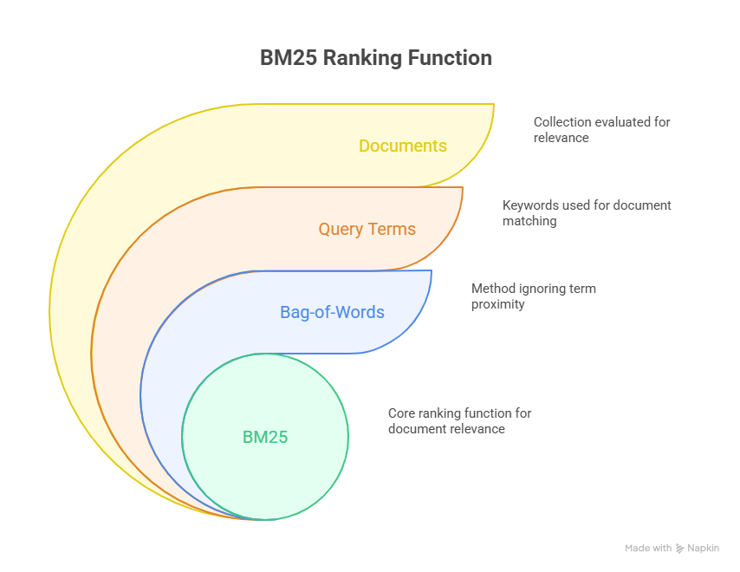
BM25 (Best Matching 25)
  Problem in RAG:
    Many retrieval systems struggle with vague or under-specified queries — especially when embeddings don’t capture the right keywords.
  BM25 Solution:
    Uses exact keyword matching and ranks based on term frequency and importance (TF-IDF)
    Efficiently retrieves documents containing precise terms from the query
www.publica.academy

Slide 18
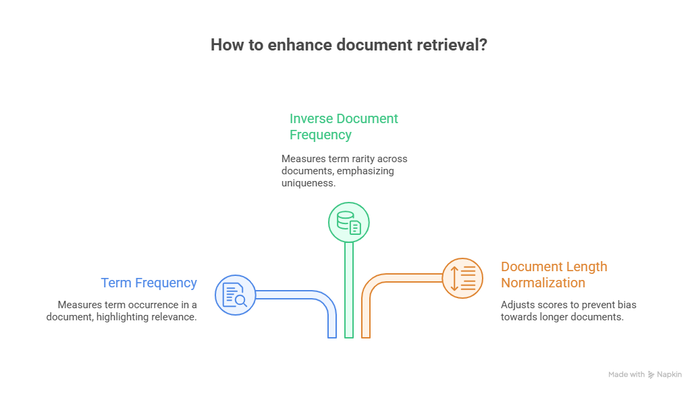
BM25 - How it Works:
  Term Frequency (TF): Measures how often a term appears in a document.
  Inverse Document Frequency (IDF): Measures how rare a term is across the entire document collection.
  Document Length Normalization: Adjusts the score based on the length of the document to prevent longer documents from being unfairly favored.
www.publica.academy

Slide 19
BM25 - Use Cases:
  Traditional Search Engines: Used as a core ranking function in many search engines.
  Information Retrieval Systems: Widely used in various information retrieval applications.
www.publica.academy

Slide 20
Semantic Splitting
    Semantic splitting involves dividing documents into chunks based on semantic boundaries rather than fixed-size segments.
    This ensures that each chunk contains a complete and meaningful unit of information.
www.publica.academy

Slide 21
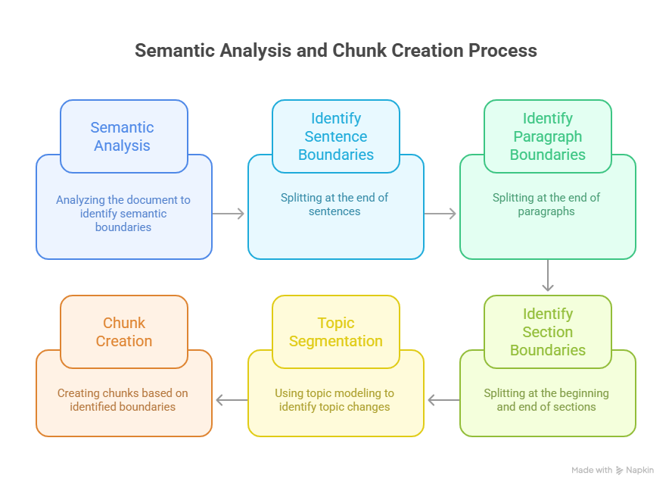
Semantic Splitting
www.publica.academy

Slide 22
Semantic Splitting
  How it Works:
  Semantic Analysis: The document is analyzed to identify semantic boundaries, such as:
    Sentence Boundaries: Splitting at the end of sentences.
    Paragraph Boundaries: Splitting at the end of paragraphs.
    Section Boundaries: Splitting at the beginning and end of sections.
    Topic Segmentation: Using topic modelling techniques to identify changes in topic.
    Chunk Creation: Chunks are created based on the identified semantic boundaries.
www.publica.academy

Slide 23
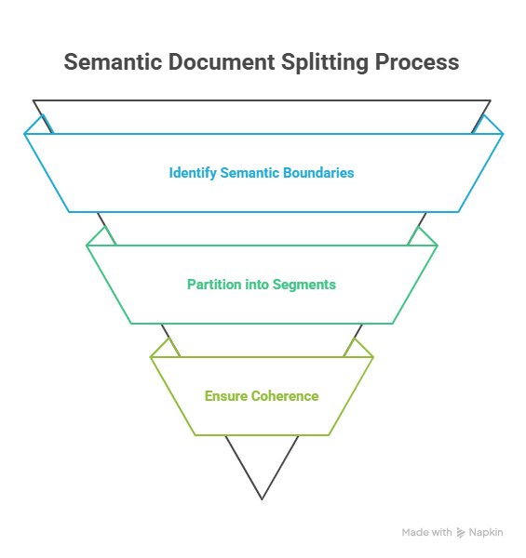
Semantic Splitting : Benefits:
    Improved Context: Each chunk contains a complete and meaningful unit of information, providing better context for retrieval.
    Reduced Noise: Avoids splitting sentences or paragraphs.
www.publica.academy

Slide 24
1
2
Glad to see you
come this far
3
4
See you in the next section
5
6
7
8
9
www.publicaai.com

